Slide 1
Modern Data Stack
Pravin Y Pawar

Slide 2
A typical TDS setup
Three major problems
Long turn-around time to untangle and set up infrastructure
Companies making use of on-premise infrastructure are responsible for all the costs associated with it
such as the army of engineers required to keep everything maintained and running smoothly.
As setup is so deeply interconnected, what may seem like a minor change might break other parts of the system
Finding the exact logical coupling between the systems requires a lot of work-hours to analyze before any improvements can
be made to the existing landscape
Slow response to new information
As the company grows, so does its data and computational power needs
Very costly in terms of resources and time when it comes to scaling out (expanding) on-premises infrastructure
leads to a limit in how much computational power there is to analyze data
data pipelines can take hours to complete, a problem that is compounded as the organization grows
A TDS requires slow ETL (Extract, Transform, Load) operations before newly ingested data can conform to the rest of the data model
A new data update can take weeks and many hours of refactoring before insights appear
By the time the data is ready, the organization is unable to act in time resulting in missed opportunities.
Expensive journey to insights
A lot of the report generation is manually done, especially when the data is coming from different sources
The report is manually generated, manually cleaned, and manually transferred to Excel
Leads to errors being made, time being taken away from other business-critical tasks, and the inability to scale.
Analysts are unable to efficiently perform their roles due to the complex landscape
Source: neptune

Slide 3
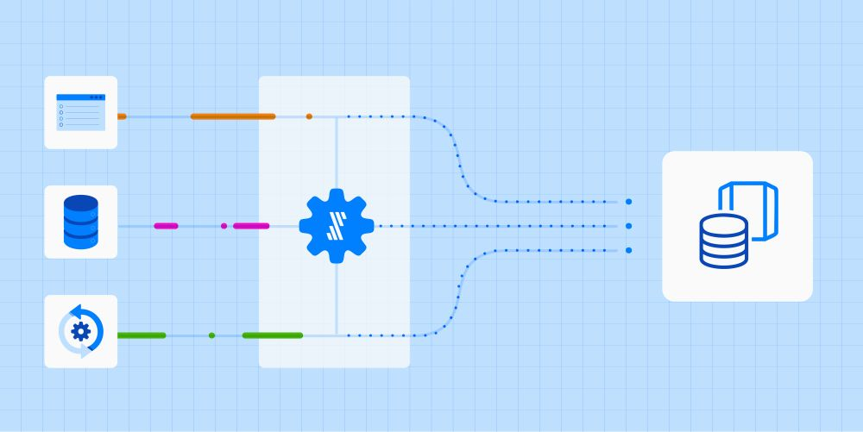
Modern Data Stack
A radically new approach to data integration saves engineering time, allowing engineers and analysts to pursue higher-value activities!
The modern data stack (MDS) is a suite of tools used for data integration. These tools include, in order of how the data flows:
a fully managed ELT data pipeline
a cloud-based columnar warehouse or data lake as a destination
a data transformation tool
a business intelligence or data visualization platform.
The goal of an MDS is to analyze business’s data to proactively uncover new areas of opportunity and improve efficiency
Source: fivetran

Slide 4
The 3 characteristics of a modern data platform
A modern platform should be…
Easy to set up
no lengthy sales process, demo calls, and implementation cycles. Just login, pay via credit card, and go!
Pay as you go
no up-front payments and million dollar licensing fees. The “modern” stack is all about putting power in the hands of the consumer, i.e. paying only for what you use
Plug and play
the modern data stack will continue to evolve and innovate, and the best of breed tools do not enforce “lock in” like tools in the legacy era, and are instead built on open standards & APIs allowing easy integration with the rest of the stack
Source: the-building-blocks-of-a-modern-data-platfor

Slide 5
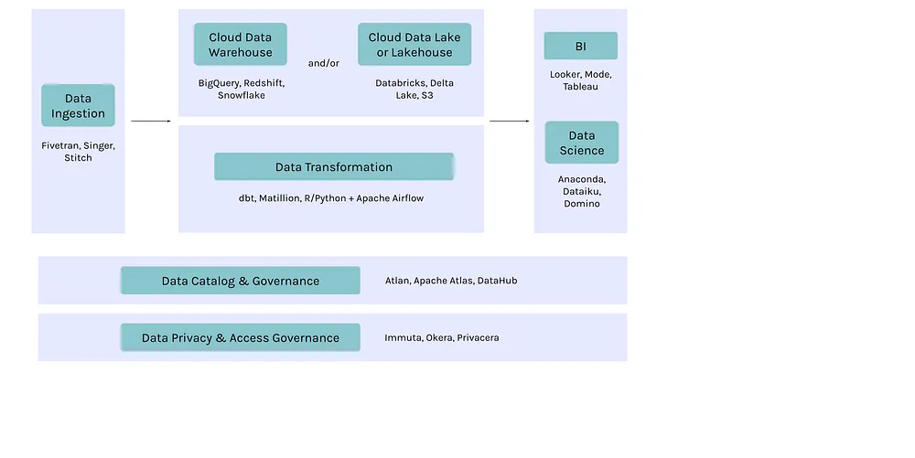
The key building blocks of a modern data platform
Source: atlan

Slide 6
The key building blocks of a MDS(2)
Modern data ingestion
Data ingestion is likely where efforts to build out a modern data platform get started
i.e. how to bring data from a variety of different data sources and ingest it into core data storage layer?
The majority of data pipelines capture data in batch, using SQL queries or extract routines, but this is changing
Many companies now prefer a streaming-first architecture that captures and processes data in real time in a continuous stream
Streaming tools use change data capture, replication, and/or publish/subscribe messaging systems to capture events as they happen, move them into the data environment, and analyze them.
Some key modern data ingestion tools:
SAAS tools: Fivetran, Hevo Data, Stitch
Open-source tools: Singer, StreamSets
Custom data ingestion pipelines built on orchestration engines like Airflow

Slide 7
The key building blocks of a MDS(3)
Modern data storage and processing
The data storage and processing layer is fundamental to the modern data platform
Architecture is evolving, typically see 3 kinds of tools or frameworks:
Data warehouses
The cornerstone of this architecture is a modern data warehouse
generally the system of choice for analysts since they optimize compute and processing speed
Key data warehouse tools include BigQuery, Redshift, and Snowflake.
Data lakes
Refers to data being stored on an object storage like Amazon S3, coupled with tools to process the data such as Spark
cheap storage systems are often used to store vast amounts of raw or even unstructured data
Key tools for data lakes:
Data storage: Amazon S3, Azure Data Lake Storage Gen2, Google Cloud Storage
Data processing engines: Databricks or Spark; Athena, Presto, or Starburst; Dremio
Data lakehouses
One of the trends is seeing this year is the long-awaited convergence of data warehouses and lakes
help unify the siloed systems that most companies have created over the last decade
a system design that combines the data management features such as ACID transactions and change data capture from a data warehouse with the low-cost storage of a data lake.

Slide 8
The key building blocks of a MDS(4)
Modern data transformation
Two core implementations seeing today for the data transformation layer
For companies with data warehouse–first architectures
tools like dbt that leverage native SQL for transformation have emerged as the top choice for data transformation
The other common implementation is using Airflow as an orchestration engine coupled with custom transformation in a programming language like Python
Key tools for data transformation:
With data warehouses: dbt, Matillion
With an orchestration engine: Apache Airflow + Python, R, or SQL

Slide 9
The key building blocks of a MDS(5)
Modern business intelligence and analytics
BI dashboards have been around for ages
but the latest breed of BI and analytics tools are built to fit within a larger modern data platform
generally more self-service platforms that allow users to explore data, rather than just consuming graphs and charts
Modern BI tools include Looker, Mode, Redash, Sigma, Sisense, Superset, and Tableau.

Slide 10
The key building blocks of a MDS(6)
While the modern data platform is great in some areas (super fast, easy to scale up, little overhead),
it struggles with bringing discovery, trust and context to data.
Key tools for modern data cataloguing and governance:
SAAS tools: Atlan
Open-source tools: Apache Atlas, LinkedIn’s DataHub, Lyft’s Amundsen
In-house tools: Airbnb’s Dataportal, Facebook’s Nemo, Uber’s Databook

Slide 11
The key building blocks of a MDS(7)
Modern data privacy and access governance
A major challenge is to be able to manage privacy controls and access governance across entire stack
While it’s still early, there have been some recent players and developments in the space and players emerging with tools
that can act as an entitlement engine to apply privacy and security policies across the data stack
Key tools for data privacy and access governance:
SAAS services: Immuta, Okera, Privacera
Open-source engines: Apache Ranger

Slide 12
Other modern data tools you should know about
Other modern data tools you should know about
Each company uses data differently, so many have added additional layers and tools for specific use cases
Real-time data processing tools
Companies that need real-time data processing generally add two additional types of tools to their data platform:
Real-time streaming pipelines: Confluent, Kafka
Real-time analytics: Druid, Imply
Data science tools
Companies that have moved past BI and analytics onto strong predictive and data science analytics often add a specific data science tool (or tools) to their data stack:
Preferred by data scientists: Jupyter Notebooks
Other options: Dataiku, DataRobot, Domino, SageMaker
Event collectors
Companies with a significant digital presence often add event collectors to log and store external events
Tools like Segment and Snowplow are key additions to their data ingestion stack.

Slide 13
Other modern data tools you should know about(2)
Data quality tools
This space is still relatively nascent, but it’s seeing a lot of activity nowadays.
seeing a few aspects of data quality incorporated throughout the data stack — data quality checks during profiling, business-driven quality rules, and unit testing frameworks within the pipeline
Data profiling
getting engulfed by data catalog and governance tools like Atlan or open source profiling frameworks like Amazon Deequ
Unit testing
Frameworks like the open-source Great Expectations are emerging and evolving, allowing unit tests to be written as a part of data pipelines itself.

Slide 14
Thank You!
Reference:
The Building Blocks of a Modern Data Platform
https://towardsdatascience.com/the-building-blocks-of-a-modern-data-platform-92e46061165
In our next session:

